Slide 1
Dirty Wars
Professor Rodrigo Lazo
Department of English
Affiliate, Chicano/Latino Studies

Slide 2
Language of Torture in the
United States After 9/11
II. J.M. Coetzee’s Waiting for the
Barbarians
III. Argentina’s Dirty War

Slide 3
TORTURE = ?
How to talk about a difficult topic?
Is torture something that language cannot capture? An experience outside of language?
Are we in US society becoming increasingly desensitized to torture?
Does the media and entertainment industry portray torture as inevitable?

Slide 4
Euphemisms for “torture”
Enhanced interrogation technique
Moderate physical pressure
Coercive interrogation
Special methods of questioning
Refined interrogation

Slide 5
OED Definition
The infliction of severe bodily pain, as punishment or a means of persuasion; spec. judicial torture, inflicted by a judicial or quasi-judicial authority, for the purpose of forcing an accused or suspected person to confess, or an unwilling witness to give evidence or information (OED)
http://www.oed.com/view/Entry/203700?r skey=5h8eoK&result=1&isAdvanced=false#eid

Slide 6
UN Convention Against Torture
For the purposes of this Convention, the term "torture" means any act by which severe pain or suffering, whether physical or mental, is intentionally inflicted on a person for such purposes as obtaining from him or a third person information or a confession, punishing him for an act he or a third person has committed or is suspected of having committed, or intimidating or coercing him or a third person, or for any reason based on discrimination of any kind, when such pain or suffering is inflicted by or at the instigation of or with the consent or acquiescence of a public official or other person acting in an official capacity. It does not include pain or suffering arising only from, inherent in or incidental to lawful sanctions.

Slide 7
Has the representation of
torture become a routine
part of entertainment in
the United States?

Slide 8

24 – Justifying torture?

Slide 9
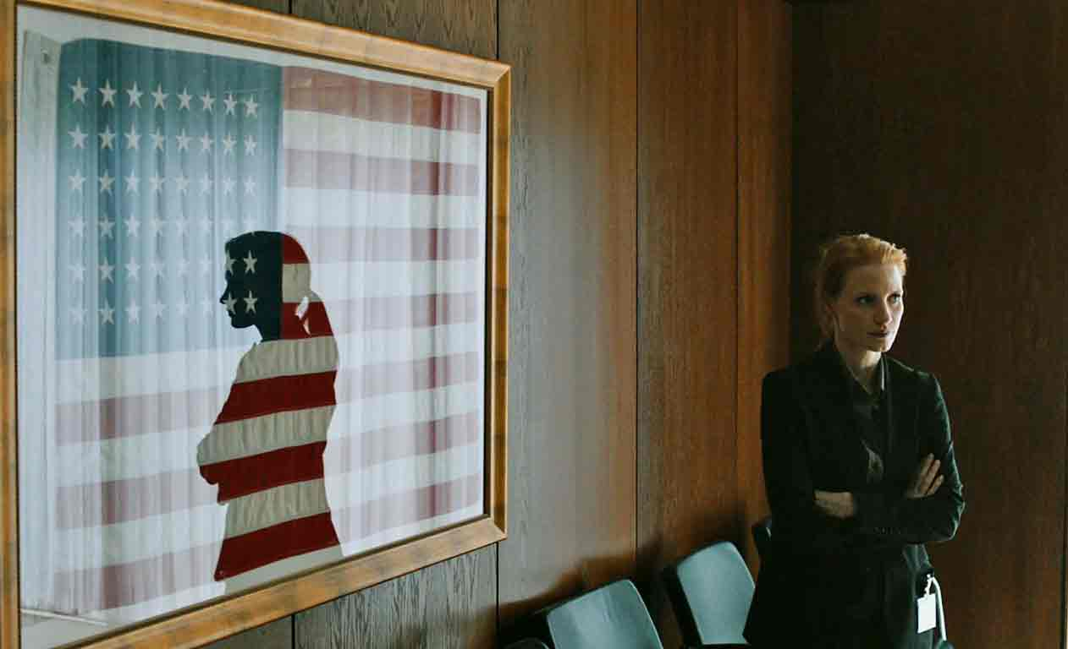
Zero Dark Thirty

Slide 10
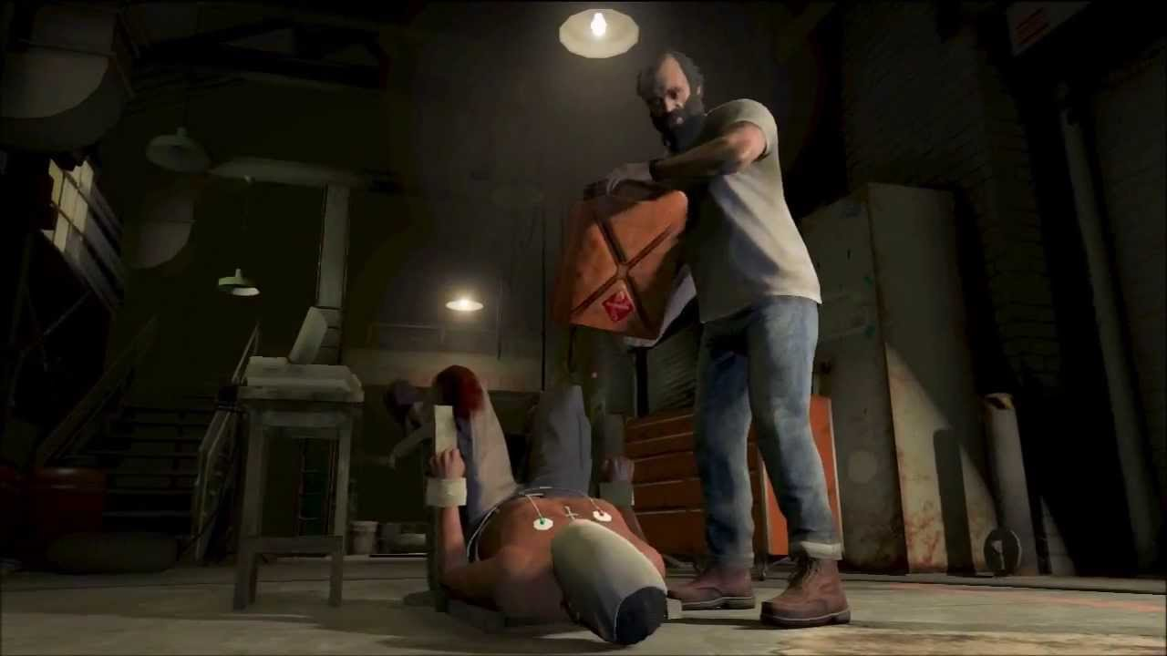
Grand Theft Auto 5

Slide 11
Are there other examples of
entertainment in which
torture is presented as part of
the action?

Slide 12
War on Terror
September 11, 2001 – Attack on the World Trade Center in New York
October 7, 2001 – US and British forces begin attacking Afghanistan. US troops are still there today.
March 20, 2003 – US invades Iraq. US military personnel withdraw December 2011.

Slide 13
VP Dick Cheney – Sept. 16, 2001
"We also have to work, though, sort of the dark side, if you will. We've got to spend time in the shadows in the intelligence world. A lot of what needs to be done here will have to be done quietly, without any discussion, using sources and methods that are available to our intelligence agencies, if we're going to be successful.”
http://georgewbush-whitehouse.archives.gov/vicepresident/news-speeches/speeches/vp20010916.html

Slide 14
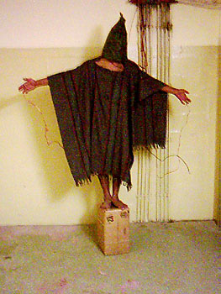
Abu Ghraib Revelations 2004

Slide 15
Memo to the President (Reader)
Alberto R. Gonzales, counsel to President Bush and later US Attorney General
The new war calls for obtaining “information from captured terrorists and their sponsors in order to avoid further atrocities against American civilians.” (176)
“The war against terrorism is a new kind of war. It is not the traditional clash between nations adhering to the laws of war…” (176)

Slide 16
Geneva Conventions - Article 3
Persons taking no active part in the hostilities, including members of armed forces who have laid down their arms and those placed hors de combat by sickness, wounds, detention, or any other cause, shall in all circumstances be treated humanely, without any adverse distinction founded on race, colour, religion or faith, sex, birth or wealth, or any other similar criteria. To this end the following acts are and shall remain prohibited at any time and in any place whatsoever with respect to the above-mentioned persons:
(a) Violence to life and person, in particular murder of all kinds, mutilation, cruel treatment and torture;
(b) Taking of hostages;
(c) Outrages upon personal dignity, in particular, humiliating and degrading treatment;
(d) The passing of sentences and the carrying out of executions without previous judgment pronounced by a regularly constituted court affording all the judicial guarantees which are recognized as indispensable by civilized peoples.

Slide 17
Gonzales considers counterarguments
“Concluding that the Geneva Convention does not apply may encourage other countries to look for technical “loopholes” in future conflicts to conclude that they are not bound by GPW either.” (177)

Slide 18
The Loophole
Al Qaeda is a terrorist organization and therefore not a part of “regular forces”
The Taliban “did not exercise full control over the territory and people” therefore it was not leading a legitimate nation-state that should come under the protection of the Geneva Conventions.

